Slide 1
Chapter-4 Electrical Signal Processing and Transmission
Er. Bishal Rimal
Lecturer
Kantipur Engineering College
Lalitpur, Nepal

Slide 2
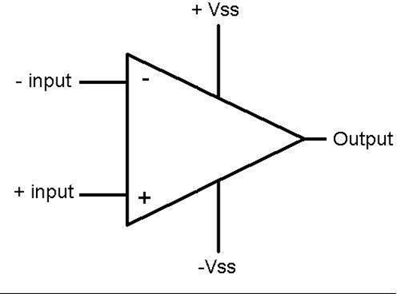
Operational Amplifier
An operational amplifier (Op-Amp) is a differential amplifier that amplifies the difference of voltages applied to its two input terminals (differential input), and provides a single- ended output.
Amplifiers are devices which take a relatively weak signal as an input and produce a much stronger signal as an output.
V+: non-inverting input
V−: inverting input
Vout: output
VS+: positive power supply
VS−: negative power supply

Slide 3
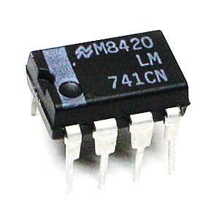
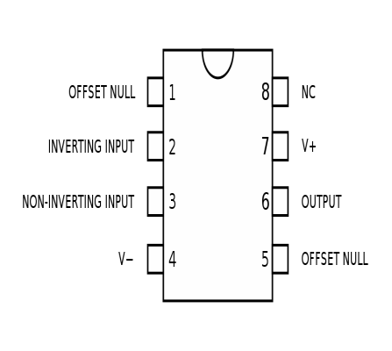
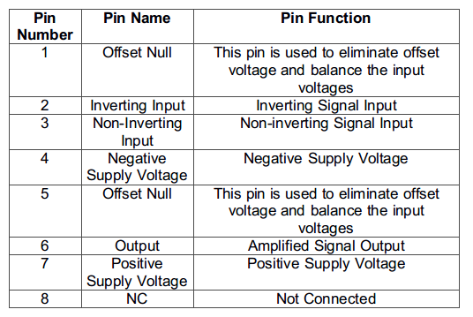
LM741

Slide 4
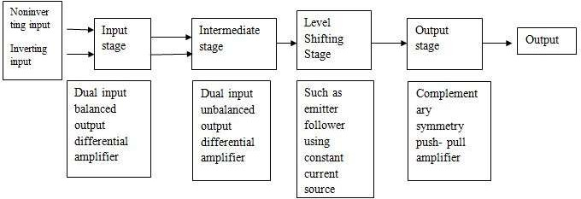
Block diagram

Slide 5
Input stage provides most of the voltage gain of OP-AMP and decides input resistance.
Intermediate stage is another differential amplifier which is driven by the output of input stage.
Due to direct coupling between the first two stages, the input of level shifting is an amplified signal with some non zero dc level.
Level shifting stage is used to bring this dc level to zero volts with respect to ground.
Output stage increase the current supplying capability of OP-AMP and also provides low output resistance.

Slide 6
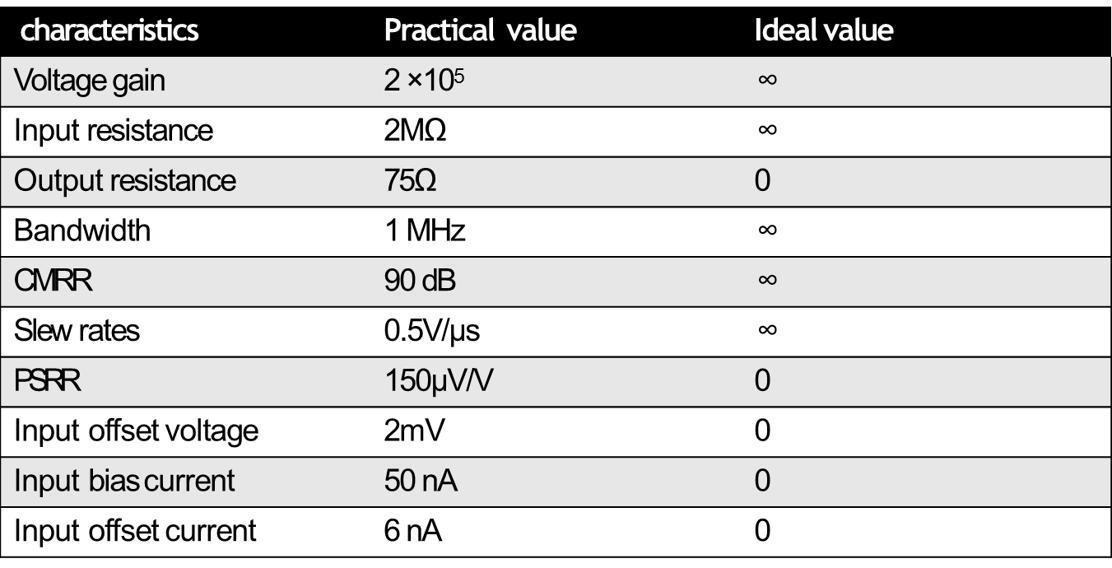
IDEAL And PRACTICAL Characteristics Of Op-Amp

Slide 7
Open loop voltage gain-It is the differential gain of an OP-AMP in the open loop mode of operation.
Input resistance-It is defined as the equivalent resistance which can be measured at either at inverting or non- inverting terminal with the other terminal connected to ground.
Output resistance-It is the resistance measured by looking into the output terminal of OP-AMP, With the input source short circuited.
Bandwidth-It is the range over which all signal frequencies are amplified almost equally.
Common mode rejection ratio-It is defined as the ratio of differential gain to common mode gain.
Notes:
op amp must have high CMRR so that it eliminates distortion in the output due to the “common mode” input. t is a measure of the rejection of the common mode signal, the signal that is the same on both the positive and negative input.

Slide 8
Cntd..
Slew rate-It is defined as the maximum rate of change of output voltage per unit time i.e maximum rate at which amplifier can respond to an abrupt change in input level.
Power supply rejection ratio-It is the change in an OP-AMPs input offset voltage caused by variation in the supply voltage/bias voltage.
Input offset voltage-Ideally, for a zero input voltage output should be zero. But practically it is not so. This is due to unavoidable unbalances inside the OP- AMP.
Input bias current-It is the average of the currents flowing into the two input terminal of the OP-AMP.
Input offset current- It is the algebraic difference between the currents flowing into the inverting and non-inverting terminal of OP-AMP

Slide 9
Signal Amplification
Signal amplification is carried out when the typical signal output level of a sensor is considered to be too low (as for instance in the case of a weak thermocouple signal, which is of the order of microvolts).
Hence the strength of weak signal needs to be increased, this boosting function is done by signal amplifier.
Some major applications of op amp in signal amplification is discussed below.

Slide 10
Signal Amplification
Buffer Amplifier
Inverting Amplifier
Non-Inverting
Summing
Difference
Differentiator
Integrator
Logarithmic
Antilog
Instrumentation

Slide 11
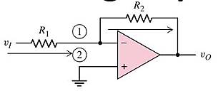



Inverting Amplifier
Inverting amplifier is one in which the output is exactly 180 degree out of phase with respect to input(i.e. if you apply a positive voltage, output will be negative).
Output is an inverted(in terms of phase) amplified version of input.
Notes:
We can increase the gain of the op-amp by changing the ratio of resistors, however, it’s not advisable to use lower resistance as Rin or R2. As the lower value of the resistance lowers the input impedance and create a load to the input signal. In typical cases value from 4.7k to 10k is used for the input resistor.
When high gain requires and we should ensure high impedance in the input, we must increase the value of feedback resistors. But it is also not advisable to use very high-value resistor across Rf. Higher feedback resistor provides unstable gain margin and cannot be an viable choice for limited bandwidth related operations. Typical value 100k or little more than that is used in the feedback resistor.
We also need to check the bandwidth of the op-amp circuit for the reliable operation at high gain.
Inverting amplifier is use full for voltage adder or summing amplifier
Inverting amplifier is applicable for the scaling summer amplifier.
It is applicable for balanced amplifier.

Slide 12
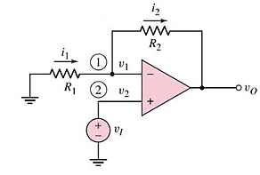
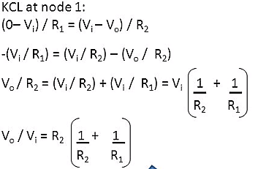

Non Inverting Amplifier
Non Inverting amplifier is one in which the output is in phase with respect to input(i.e. if you apply a positive voltage, output will be positive ).
Output is an Non inverted(in terms of phase) amplified version of input.
Notes:
A non inverting amplifier uses a voltage divider bias negative feedback connection.
Here the voltage gain is always greater than 1.

Slide 13
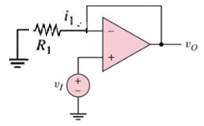
Voltage Follower/ Buffer
Here if R₂=0, Av=1
i.e V₀=V_{i}
Used to isolate stages from each other.
Used as an impedance transformer.
Reduce power consumption of the source
Reduce distortion from overloading, distortion and other electromagnetic interference.
Check R2=0 condition.
Notes:
High input impedance and a very low output impedance
Voltage followers are generally used to isolate stages from each other.
Voltage follower is also called as a voltage buffer.
Thus,
The output directly tracks the input voltage in sign and magnitude.
Voltage followers are generally used to isolate stages from each other.
This is an impedance transformer because it converts voltage at high impedance to voltage at low impedance.From i/p it draws a minimum current as it have high impedance and drive the load as a perfect voltage source as it has low output impedance.

Slide 14
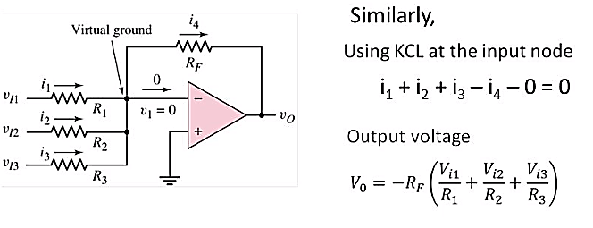
Summer/ Adder
If R_{f}=R1=R2=R3
Then, V₀= -(V_{i1}+V_{i2}+V_{i3} )
Thus,
Output signal is the sum of all input signals.
Notes:
Summing amplifier is also called as a bipolar amplifier or a uni-polar converter.
Summing amplifier converts digital to analog converter

Slide 15
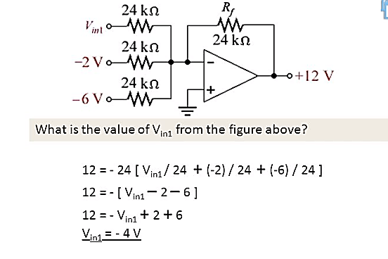
Numerical

Slide 16
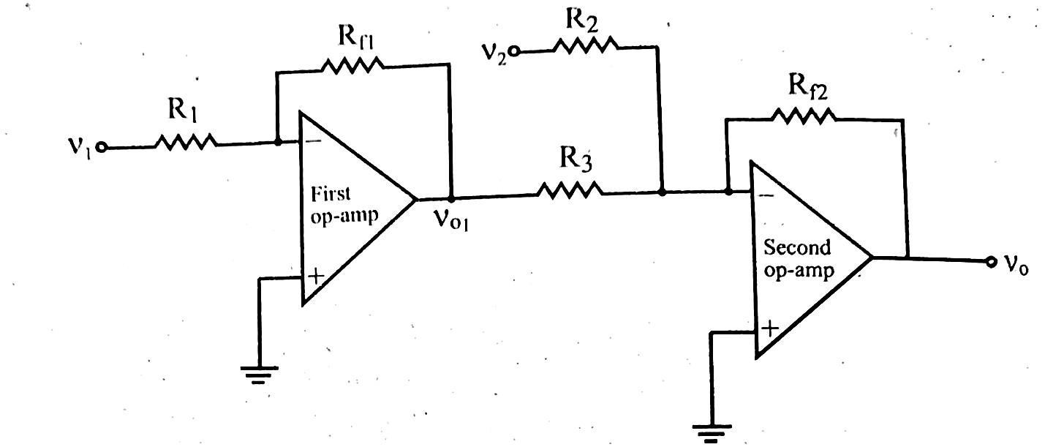
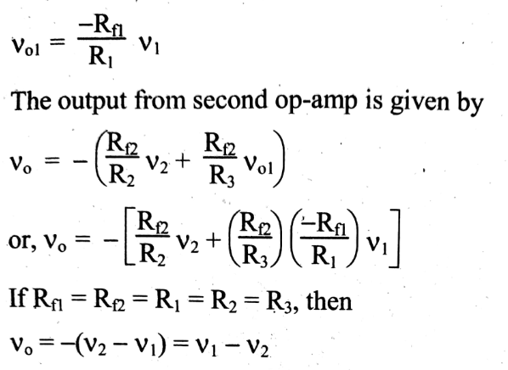
Differential (Subtractor)
Thus,
Output signal is difference of two input signals

Slide 17
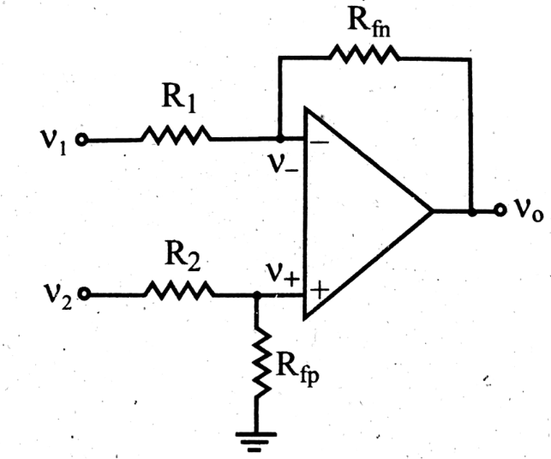
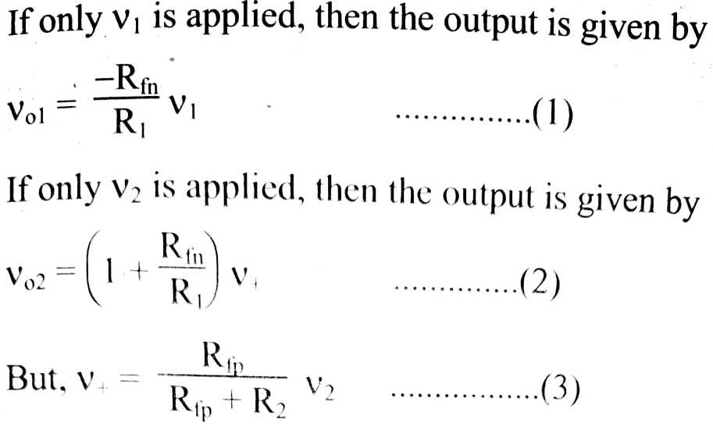
Differential/Subtracter
Alternative method
Using superposition theorem,
+
+
Hints:
Eq 3 is obtained using voltage divider rule.
i.e voltage across V+ is voltage on Rfp due to V2 source

Slide 18
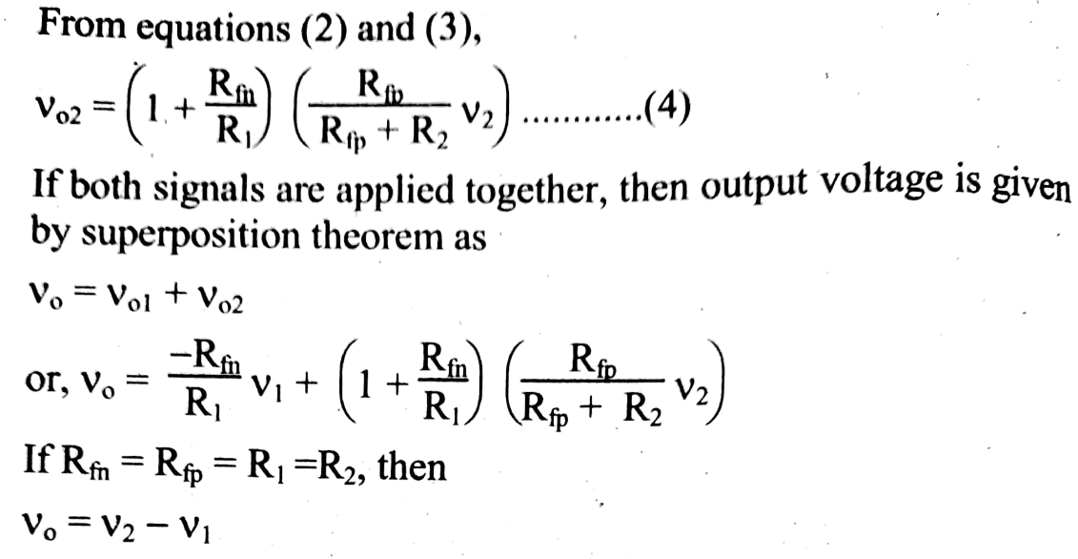
Generally, we use differential amplifier that acts as a volume control circuit.
The differential operational amplifier can be used as an automatic gain control circuit.
Some of the differential operational amplifier can be used for Amplitude modulation.
Notes:
It is used as a series negative feedback circuit by using op amplifier

Slide 19
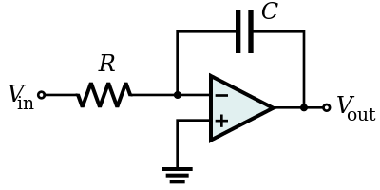
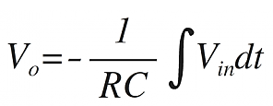
Integrator
An integrator in measurement and control applications is an element whose output signal is the time integral of its input signal.
It accumulates the input quantity over a defined time to produce a representative output.
used to perform calculus operations in analogue computers.
used in analogue-to-digital converters, ramp generators and also in wave shaping applications.
This application of an integrator is sometimes called a totalizer in the industrial instrumentation trade.
Notes:
used to perform calculus operations in analogue computers.
used in analogue-to-digital converters, ramp generators and also in wave shaping applications.
This application of an integrator is sometimes called a totalizer in the industrial instrumentation trade.

Slide 20

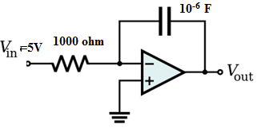
Design of integrator to produce ramp voltage of -5v/ms.
Let V_{in}=5v
We know
Then, V_{o}=-5t/RC
Now, V_{o}/t=-5/RC v/s…………………………(1)
From question, V_{o}/t=-5v/ms= -5000v/s….(2)
Equating 1 and 2 we get;
RC=10⁻³
_{Now} we have to chose value R and C such that its multiple is 10⁻³ ,so let R=1000 ohm then C=10⁻⁶ F
The designed ckt is shown alongside.
Notes:
Choose voltage around 0-12v and R in k Ohm and C in Micro Farad.

Slide 21
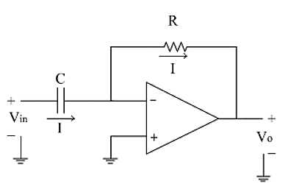

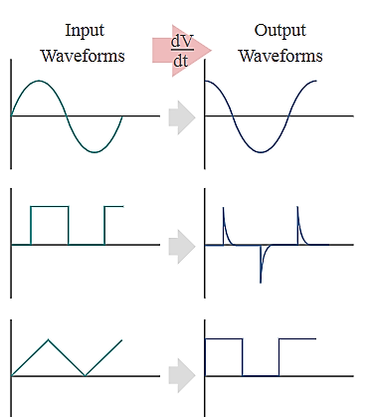
Differentiator
It is the circuit that perform mathematical differentiation of input signal.
Eg. If input is triangular wave, output is square wave.
Used most widely in process instrumentation i.e used to monitor the rate of change of various points.
Notes:
The input signal to the differentiator is applied to the capacitor. The capacitor blocks any DC content so there is no current flow to the amplifier summing point, X resulting in zero output voltage. The capacitor only allows AC type input voltage changes to pass through and whose frequency is dependant on the rate of change of the input signal.
At low frequencies the reactance of the capacitor is “High” resulting in a low gain ( Rƒ/Xc ) and low output voltage from the op-amp. At higher frequencies the reactance of the capacitor is much lower resulting in a higher gain and higher output voltage from the differentiator amplifier.
However, at high frequencies an op-amp differentiator circuit becomes unstable and will start to oscillate. This is due mainly to the first-order effect, which determines the frequency response of the op-amp circuit causing a second-order response which, at high frequencies gives an output voltage far higher than what would be expected. To avoid this the high frequency gain of the circuit needs to be reduced by adding an additional small value capacitor across the feedback resistor Rƒ.

Slide 22
Assignment 2
1.List out the ideal characteristics of Op-Amp.
2.Design an integrator circuit with output ramp voltage
of -20V/ms.
3.Derive the expression for gain and list out application of op-amp under following configuration
Inverting
Non-inverting
Summer
Subtractor
Integrator
Differentiator

Slide 23
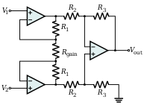
Instrumentation Amplifier
The output signal produced by transducers is very weak so need to be amplified before further processing which is done by instrumentation amplifier.
An instrumentation amplifier is a differential op-amp circuit providing high input impedances with ease of gain adjustment through the variation of a single resistor(Rgain) in figure alongside.
.
Instrumentation amplifiers are used where great accuracy and stability of the circuit both short and long-term are required.
Notes:
It is very common for sensors to require some degree of amplification. This is the commonest
form of signal conditioning, to convert a low-level voltage or current into a higher level in a
standardized range such as 0 to 5 volts. For experimental purposes and for short term needs this
can usually be done through an op-amp (instrumentation amp). Industrial sensors will often have
the instrumentation amplifiers built into the sensor module. They can also be purchased as
separate modules and added to an existing system.
Instrumentation Amplifier working principles
A differential amplifier has two types of inputs: common mode input CM and Differential mode
input DM. What one needs is to amplify Dm and reject CM. Thus CM gain has to be low and
DM gain has to be high. In instrumentation amplifier, two buffers are used to buffer the signal.
Here the CM gain is 1. However, DM gain can be quite high, typically 10 or even 100. In next
stage, the two signals get fed to a differential amplifier, whose CM gain is pretty low and can be
made zero by an external pot in some cases. The DM gain of this stage can also be 1 or 5 or 10.
Thus even if the CM signal has a nonzero source resistance, the CM output of first stage is true
CM signal, and hence they get rejected very much in second stage.

Slide 24
Feature of Instrumentation amplifier
Single resistor gain adjustment with high accuracy.
High CMRR so that it eliminates the distortion
High stability of gain due with low temperature coefficient.
Low output impedance
Notes:
Low dc offset and drift error reffered to input

Slide 25
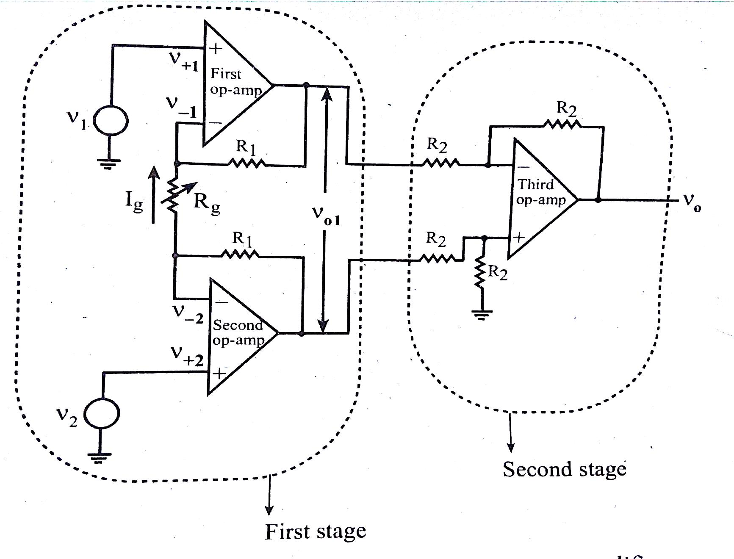

Fig Instrumentation amplifier
First stage is carefully matched op-amps
Second stage is generally unity gain differential amplifier.
Changing the value of Rg will change its gain.

Slide 26
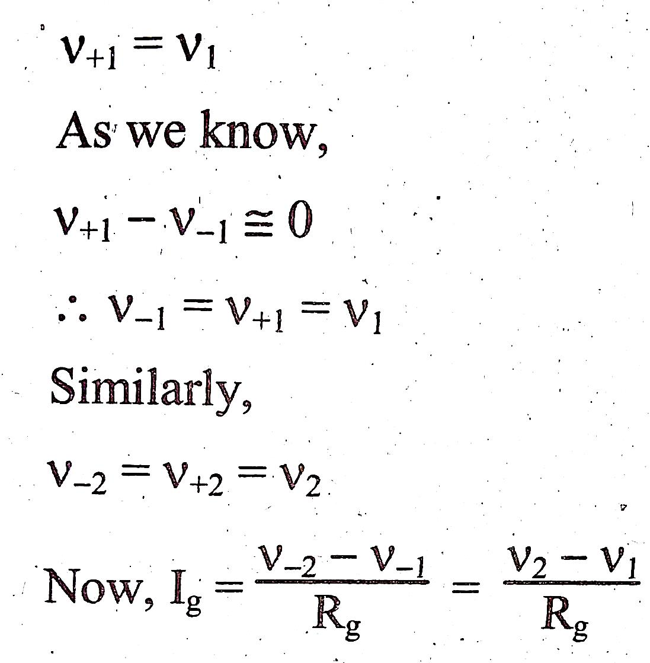
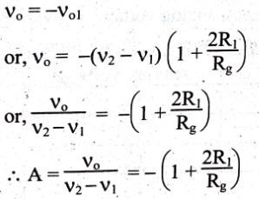
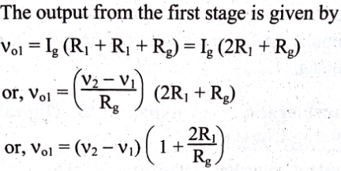
As the second stage is unity gain differential amplifier, output is given by:
Thus by changing the value of Rg, gain of the amplifier can be changed.

Slide 27
Network Isolation
Here if R₂=0, Av=1
i.e V₀=V_{i}
Used to isolate stages from each other electrically.
Used as an impedance transformer.
Reduce power consumption of the source
Reduce distortion from overloading, distortion and other electromagnetic interference.
Same as isolation buffer

Slide 28
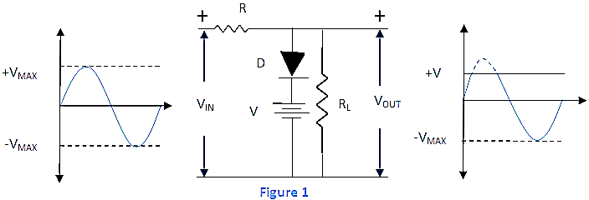
Wave Shaper
Modification of time varying electrical signals (V,I) using combination of electronics devices
May be linear or non-linear
E.g Clipper circuit clips out the certain portion of waveform. They are non linear wave shaping as they involve transistors or diodes.
Notes:
Modification of time varying electrical signals (V,I) using combination of electronics devices
Such as transistor, analog n digital ic, R, L, C etc.
Linear waveshaping involves passage of signal through linear combination of devices like R. i.e don’t change the waveform of i/p signal
Nonlinear ws involves passage of signal through non linear devices like diode, transistors etc. here waveform of i/p is changed

Slide 29
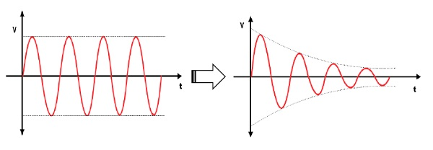
Signal Attenuation
Attenuation is a reduction of signal strength during transmission.
Attenuation occurs with any type of signal, whether digital or analog.
Sometimes called loss, attenuation is a natural consequence of signal transmission over long distances.
Attenuation is a natural phenomenon that cannot be prevented while transmitting signals but we can use repeater to amplify the signal again.
Op-amp with closed loop gain, A <1 are attenuator
Notes:
When a signal travels through a medium its energy is lost, resulting in decrease in the amplitude of the wave i.e. with the distance of propagation the strength of the signals becomes weak and this phenomenon is known as attenuation.

Slide 30
Noise
Unwanted signal introduced upon desired signal is noise.
Degrades the quality of desired signal.
Electronic component produces some noise when assembled to build a combine system. These noise might get superimposed with the desired signal. These noise may get interfaced with the information contained in the circuit.
E.g Thermal noise(thermal agitations), Shot noise(random fluctuations in motion of charge carrier), Flicker noise(1/f noise), Burst noise(Popcorn/imperfections), Avalanche noise etc..
Notes:
thermal, Johnson or Nyquist noise) is unavoidable, and generated by the random thermal motion of charge carriers (usually electrons), inside an electrical conductor, which happens regardless of any applied voltage.
Shot noise in electronic devices results from unavoidable random statistical fluctuations of the electric current when the charge carriers (such as electrons) traverse a gap. If electrons flow across a barrier, then they have discrete arrival times. Those discrete arrivals exhibit shot noise.
Flicker noise, also known as 1/f noise, is a signal
If the time taken by the electrons to travel from emitter to collector in a transistor becomes comparable to the period of the signal being amplified, that is, at frequencies above VHFand beyond, the transit-time effect takes place and noise input impedance of the transistor decreases. From the frequency at which this effect becomes significant, it increases with frequency and quickly dominates other sources of noise.

Slide 31
Reduction of Noise in electronic circuit
Keep the signal wires short.
Keep the wires away from electrical machinery.
Use twisted together wires.
Use differential inputs to remove noise common the both wires.
Filter the signal.

Slide 32
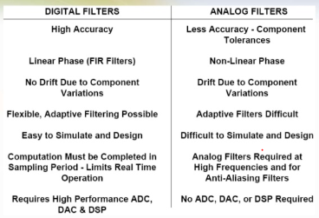
Analogue and Digital filtering
Filters are frequency selective circuits
Analog filter
Process continuous time signal
Low accuracy
Difficult to simulate and design
Types
Active filter
▪ More common at lower frequencies
Passive filter
▪ More common at higher frequencies
Digital Filter
Process discrete time signal
High accuracy
Easy design and simulation
Types
IIR( Infinite Impulse Response)
FIR (Finite Impulse Response)

Slide 33
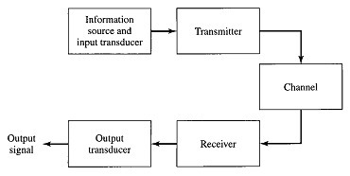
Communication System
Communication system is a system designed to send information from a source to destination. Information may be voice, data, video etc.
Fig: Block diagram of General communication system

Slide 34
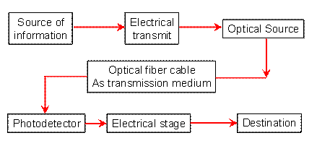
Optical Communication System
Communication through light
Transmission medium is Optical fibre.
Fig: Block Diagram of Optical Fiber communication system
Notes:
Optical source which provide electrical optical conversion may be either semiconductor laser or LED
Modulation and demodulation

Slide 35
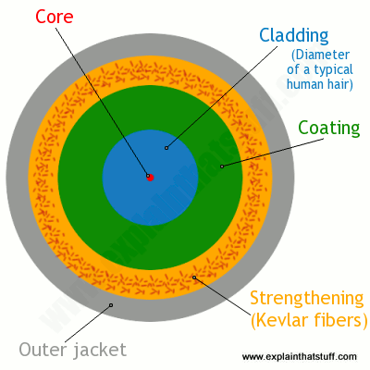
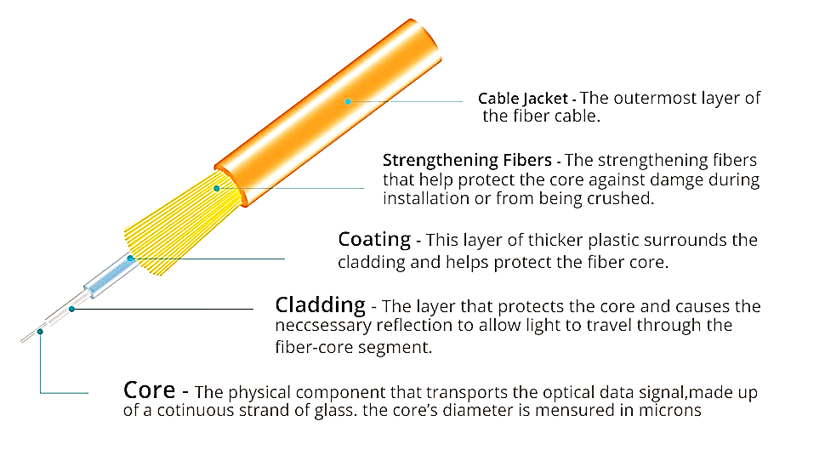
Optical Fiber
Notes:
Core 10 to 100micrometer of glass or silica or plastic of high refractive index
RI of cladding is less than that of core.(RI difference is about 10^-3).
May be step index fiber (RI of core and cladding changes abundantly)
Or Graded index fibre( RI of core to cladding change gradually)

Slide 36
Working of Optical fibre
Works on the principle of total internal reflection (i.e. Incident angle is greater than critical angle in denser medium) at core cladding interference.
When light enters core at small angle, it suffers refraction and strike core cladding interface.
Then light suffers total internal reflection.
After suffering such repeated total internal reflection, ray of light will reach at other end.
At the end it suffers refraction and emerge out from optical fiber.
Thus light inside the fiber travels in a guided manner so also known as optical waveguide.

Slide 37
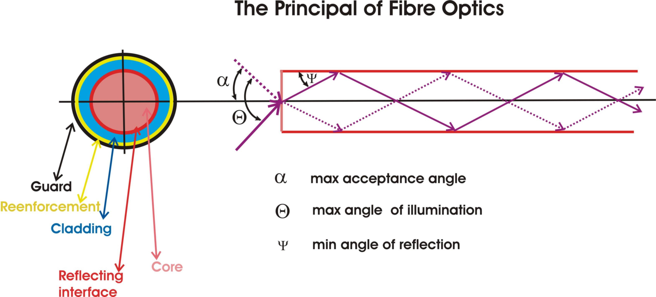

Slide 38
Advantage of Optical Communication System
Increased Bandwidth and Channel Capacity
Low Signal Attenuation
Immune to Noise
No Crosstalk
Lower Bit Error Rates
Signal Security
Electrical Isolation
Reduced Size and Weight of Cables
Radiation Resistant and Environment Friendly
Resistant to Temperature Variations etc.

Slide 39
Disadvantage of Optical Communication System
Specialist skills needed
Cost of installation
Cost of transmission equipment from electrical to optical signals
Optical fibers can not carry electrical power
Mechanically weak

Slide 40
Application
As fibers are very flexible, they are used in flexible digital cameras.
Fibers are used in mechanical imaging i.e. for inspection of mechanical welds in pipes and engines of rockets, space shuttles, airplanes.
Fibers are used in medical imaging such as endoscopes and laparoscopes.
Fibers can be used under sea communication.
Fibers are used in military applications such as aircrafts, ships, tanks etc.
Nuclear testing applications use optical fiber phase sensors and transducers
Fibers are used in public utility organizations like railways, TV transmission etc.
Fibers are used in LAN systems of offices, industrial plants and colleges etc.
Fibers are used in telecommunication such as voice telephones, video phones, telegraph services, message services and data networks

Slide 41
conversion devices
Electro optic
Opto electric
Converts electrical into photo ionic energy.
Eg. LED, Laser diode, photoemissive cell etc.
Converts photo ionic energy into electrical energy
Eg. LDR, Solar cell, photo diodeetc.

Slide 42
Assignment 3
Explain about 3 op-amp instrumentation Amplifier with their features.
What is communication of data in instrumentation system?
How data are transferred in Optical fiber communication system?
Discuss about advantage and disadvantage of optical fiber over conventional data transmission system.

Slide 43
Thank You!!

